Slide 1


24RL-1F029_ELEM
Epigenetic influence of human Long-term environmental Exposure to Metals
Progress and Achievements 2024–2026
PI: Prof Jonathan Schug | Co-PI: Dr Ani Stepanyan

Slide 2
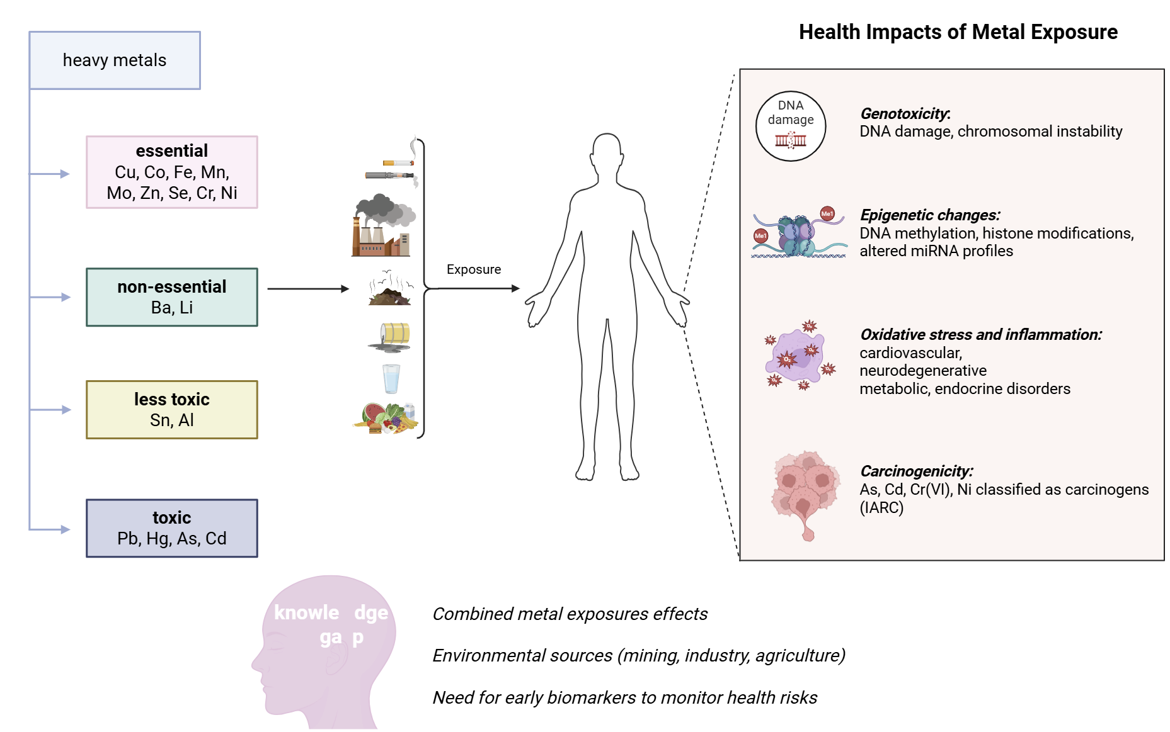
Metals and Health Status: State-of-the-Art

Slide 3
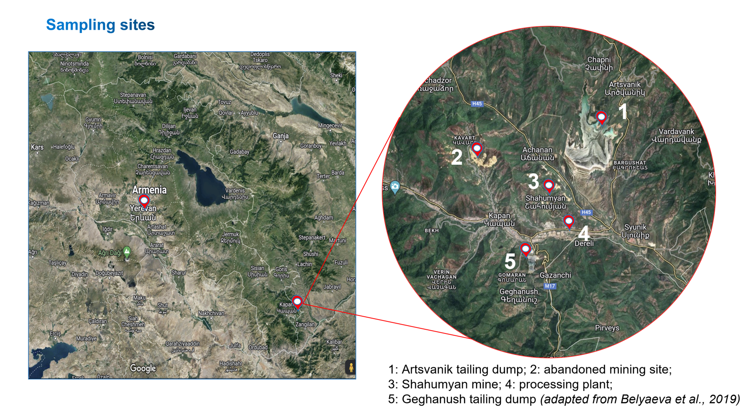
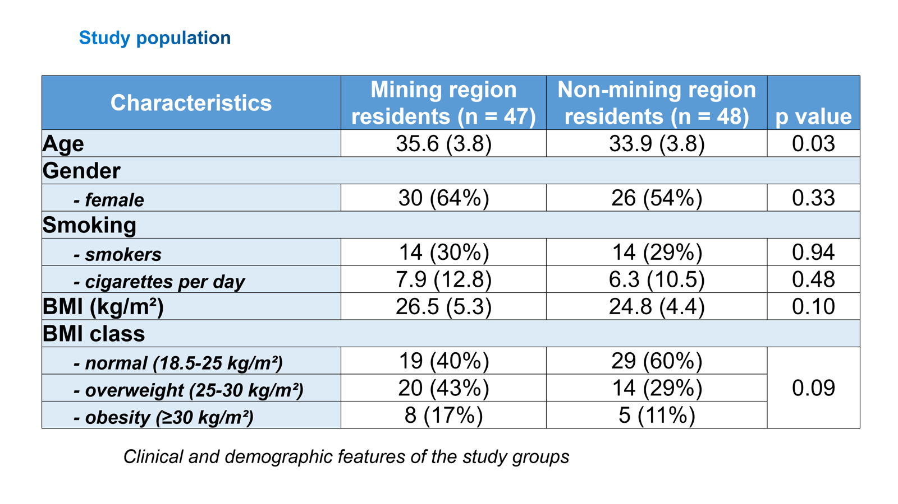
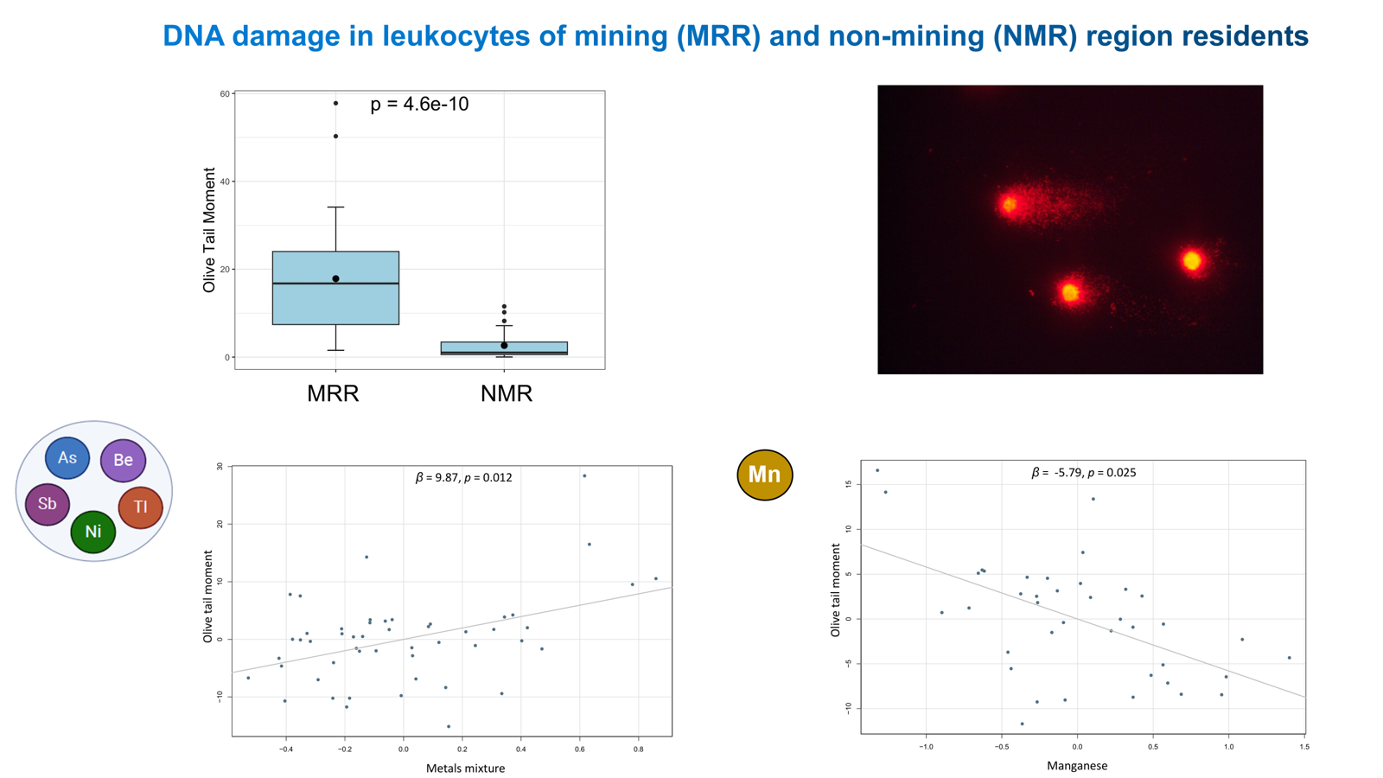
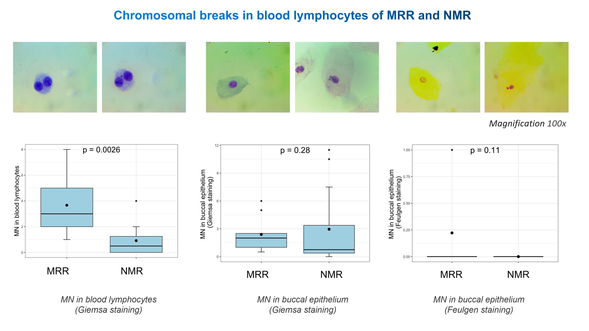
Study design

Slide 4
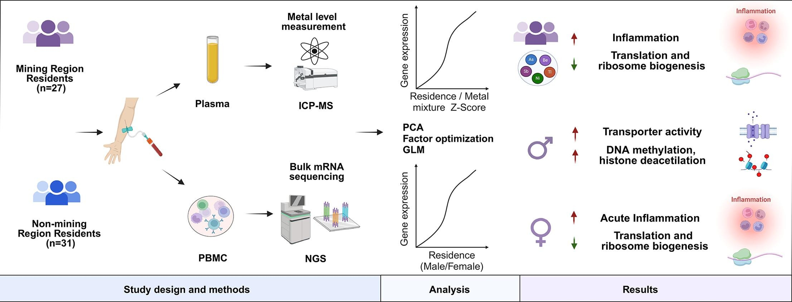

Transcriptome alterations in long-term mining region residents: Insights into immune response and molecular pathways
Stepanyan A, Arakelyan A, Schug J. Transcriptome alterations in long-term mining region residents: Insights into immune response and molecular pathways. Environ Int. 2025 Mar;197:109344. doi: 10.1016/j.envint.2025.109344. Epub 2025 Feb 21. PMID: 40023890.

Slide 5
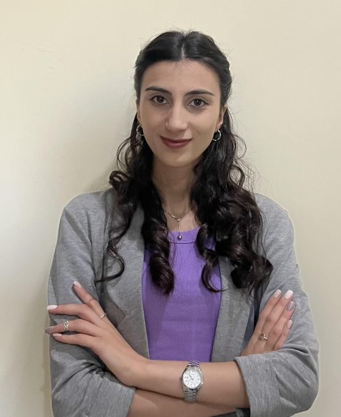
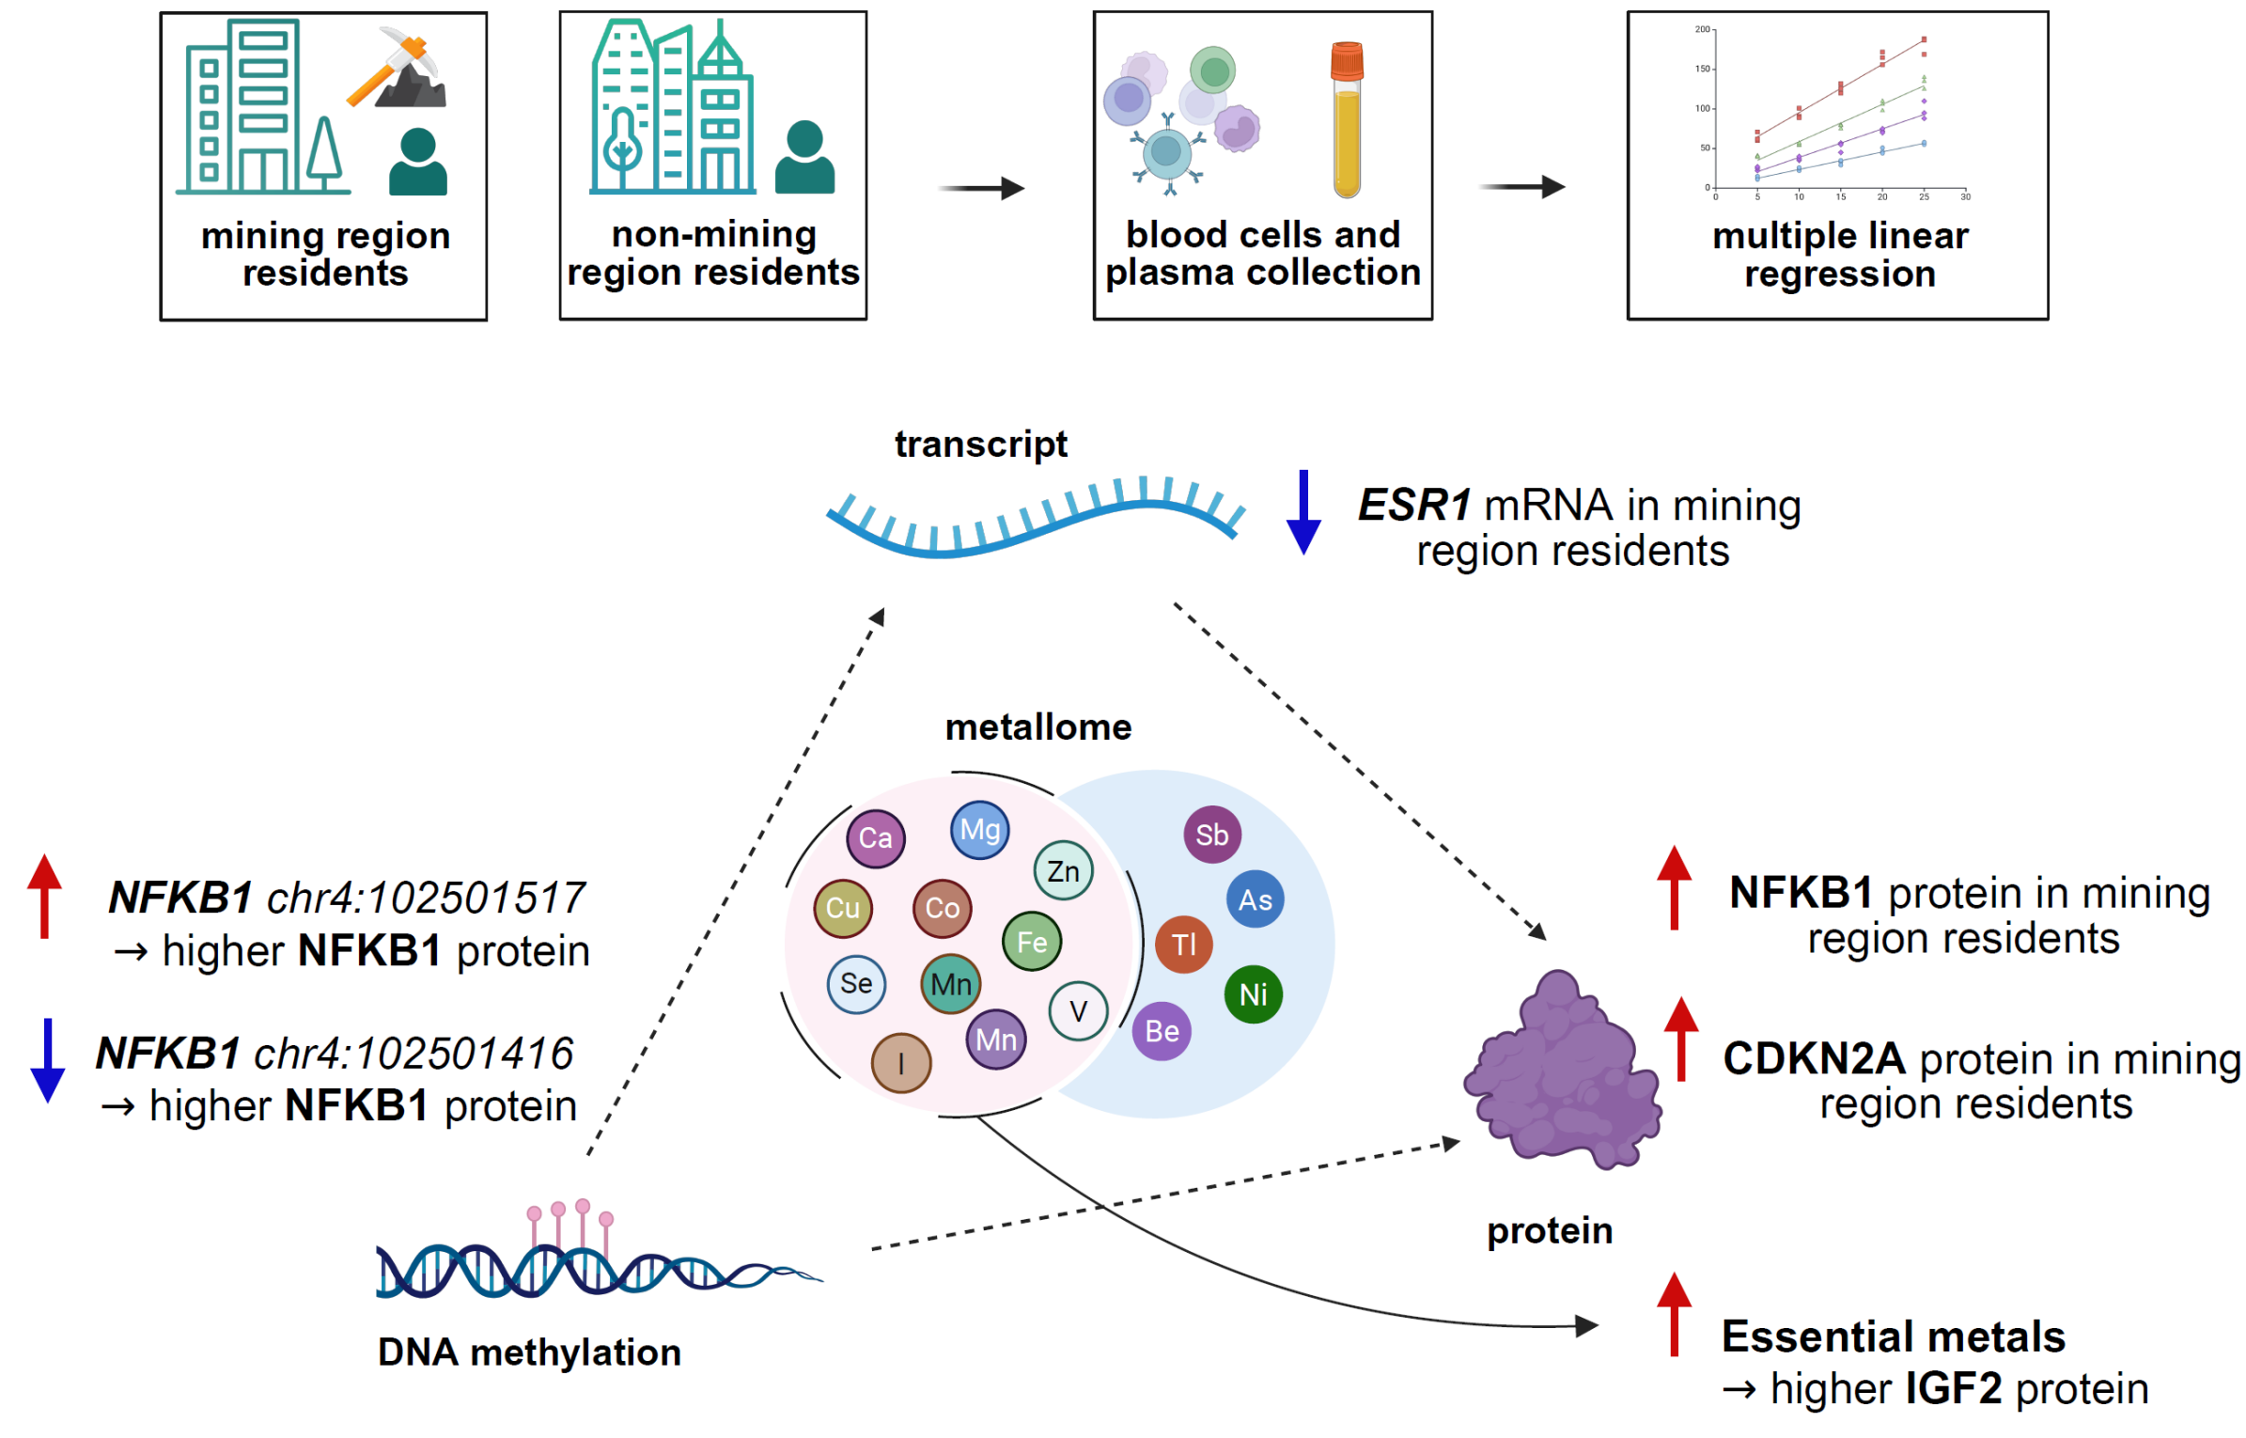
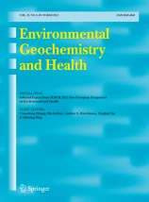
Integrated analysis of the blood metallome and DNA methylation, gene expression, and protein levels of immune-associated genes in residents from mining region
Yeva Bareghamyan,
PhD student
Bareghamyan Y, Minasyan A, Davitavyan S, Petrackova A, Savara J, Nesnadna R, Kriegova E, Schug J, Arakelyan A, Stepanyan A. Integrated analysis of the blood metallome and DNA methylation, gene expression, and protein levels of immune-associated genes in residents from mining region. Environ Geochem Health. 2026 Jan 4;48(2):81. doi: 10.1007/s10653-025-02958-z. PMID: 41485189; PMCID: PMC12765743.

Slide 6



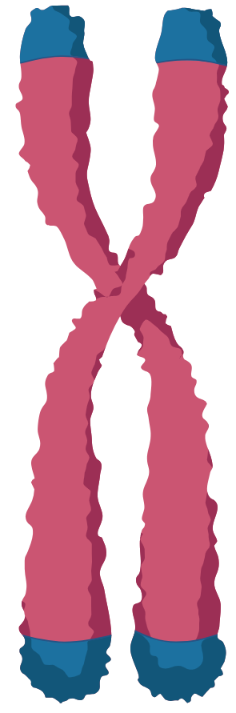
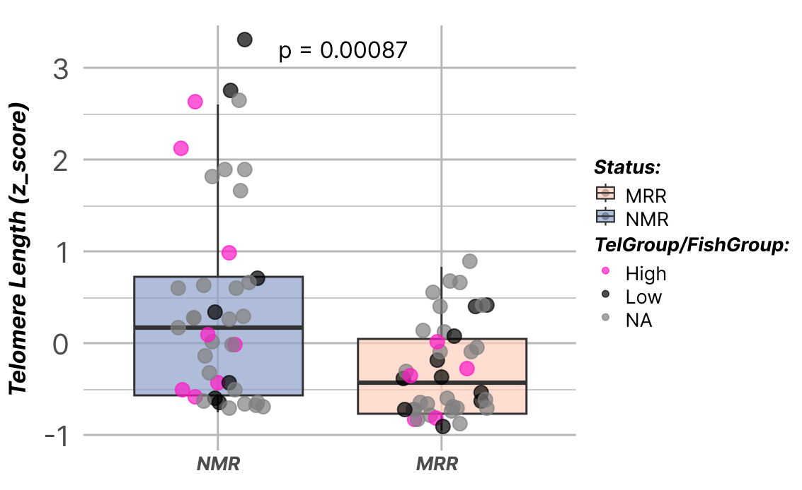
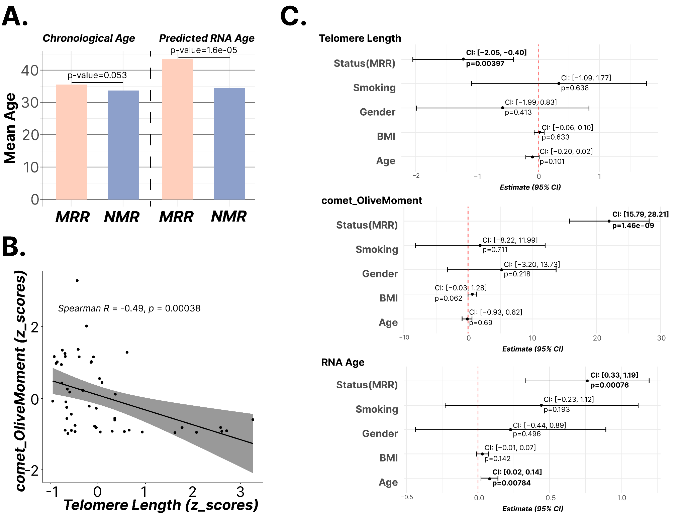


Accelerated biological aging ?
Cell division
Hovsep Ghazaryan,
PhD
Suren Davitavyan,
PhD
Chromosome
↓Telomere length

Slide 7












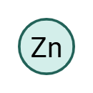
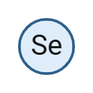


















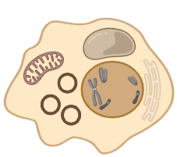


Metal Contribution Profiles
MRR
NMR
RAD52
RAD52

Slide 8
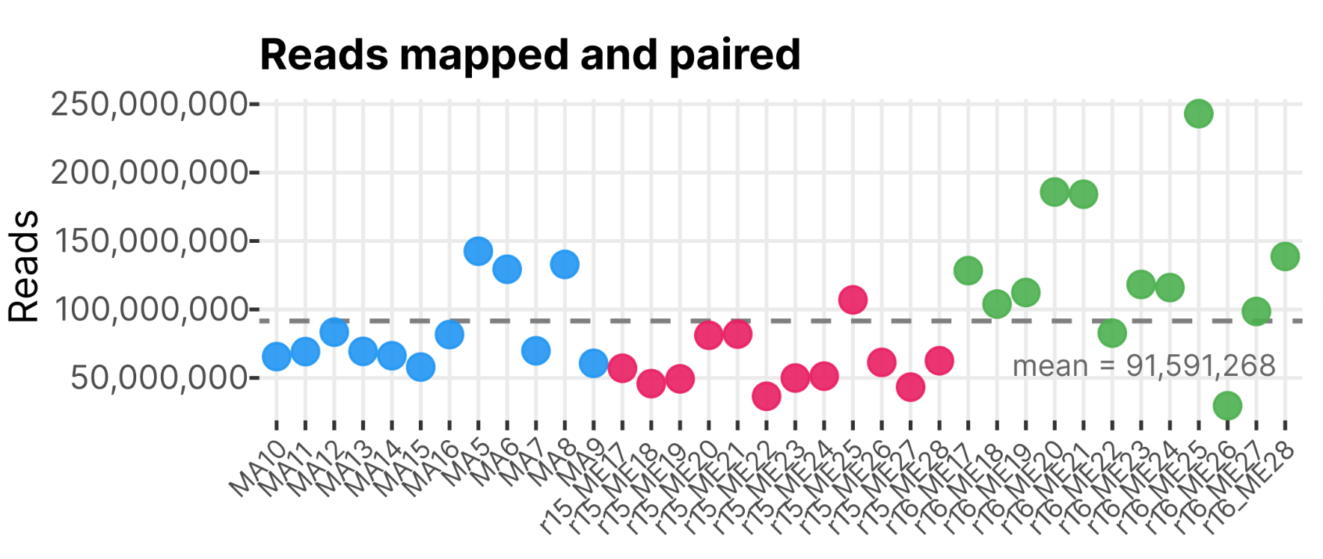
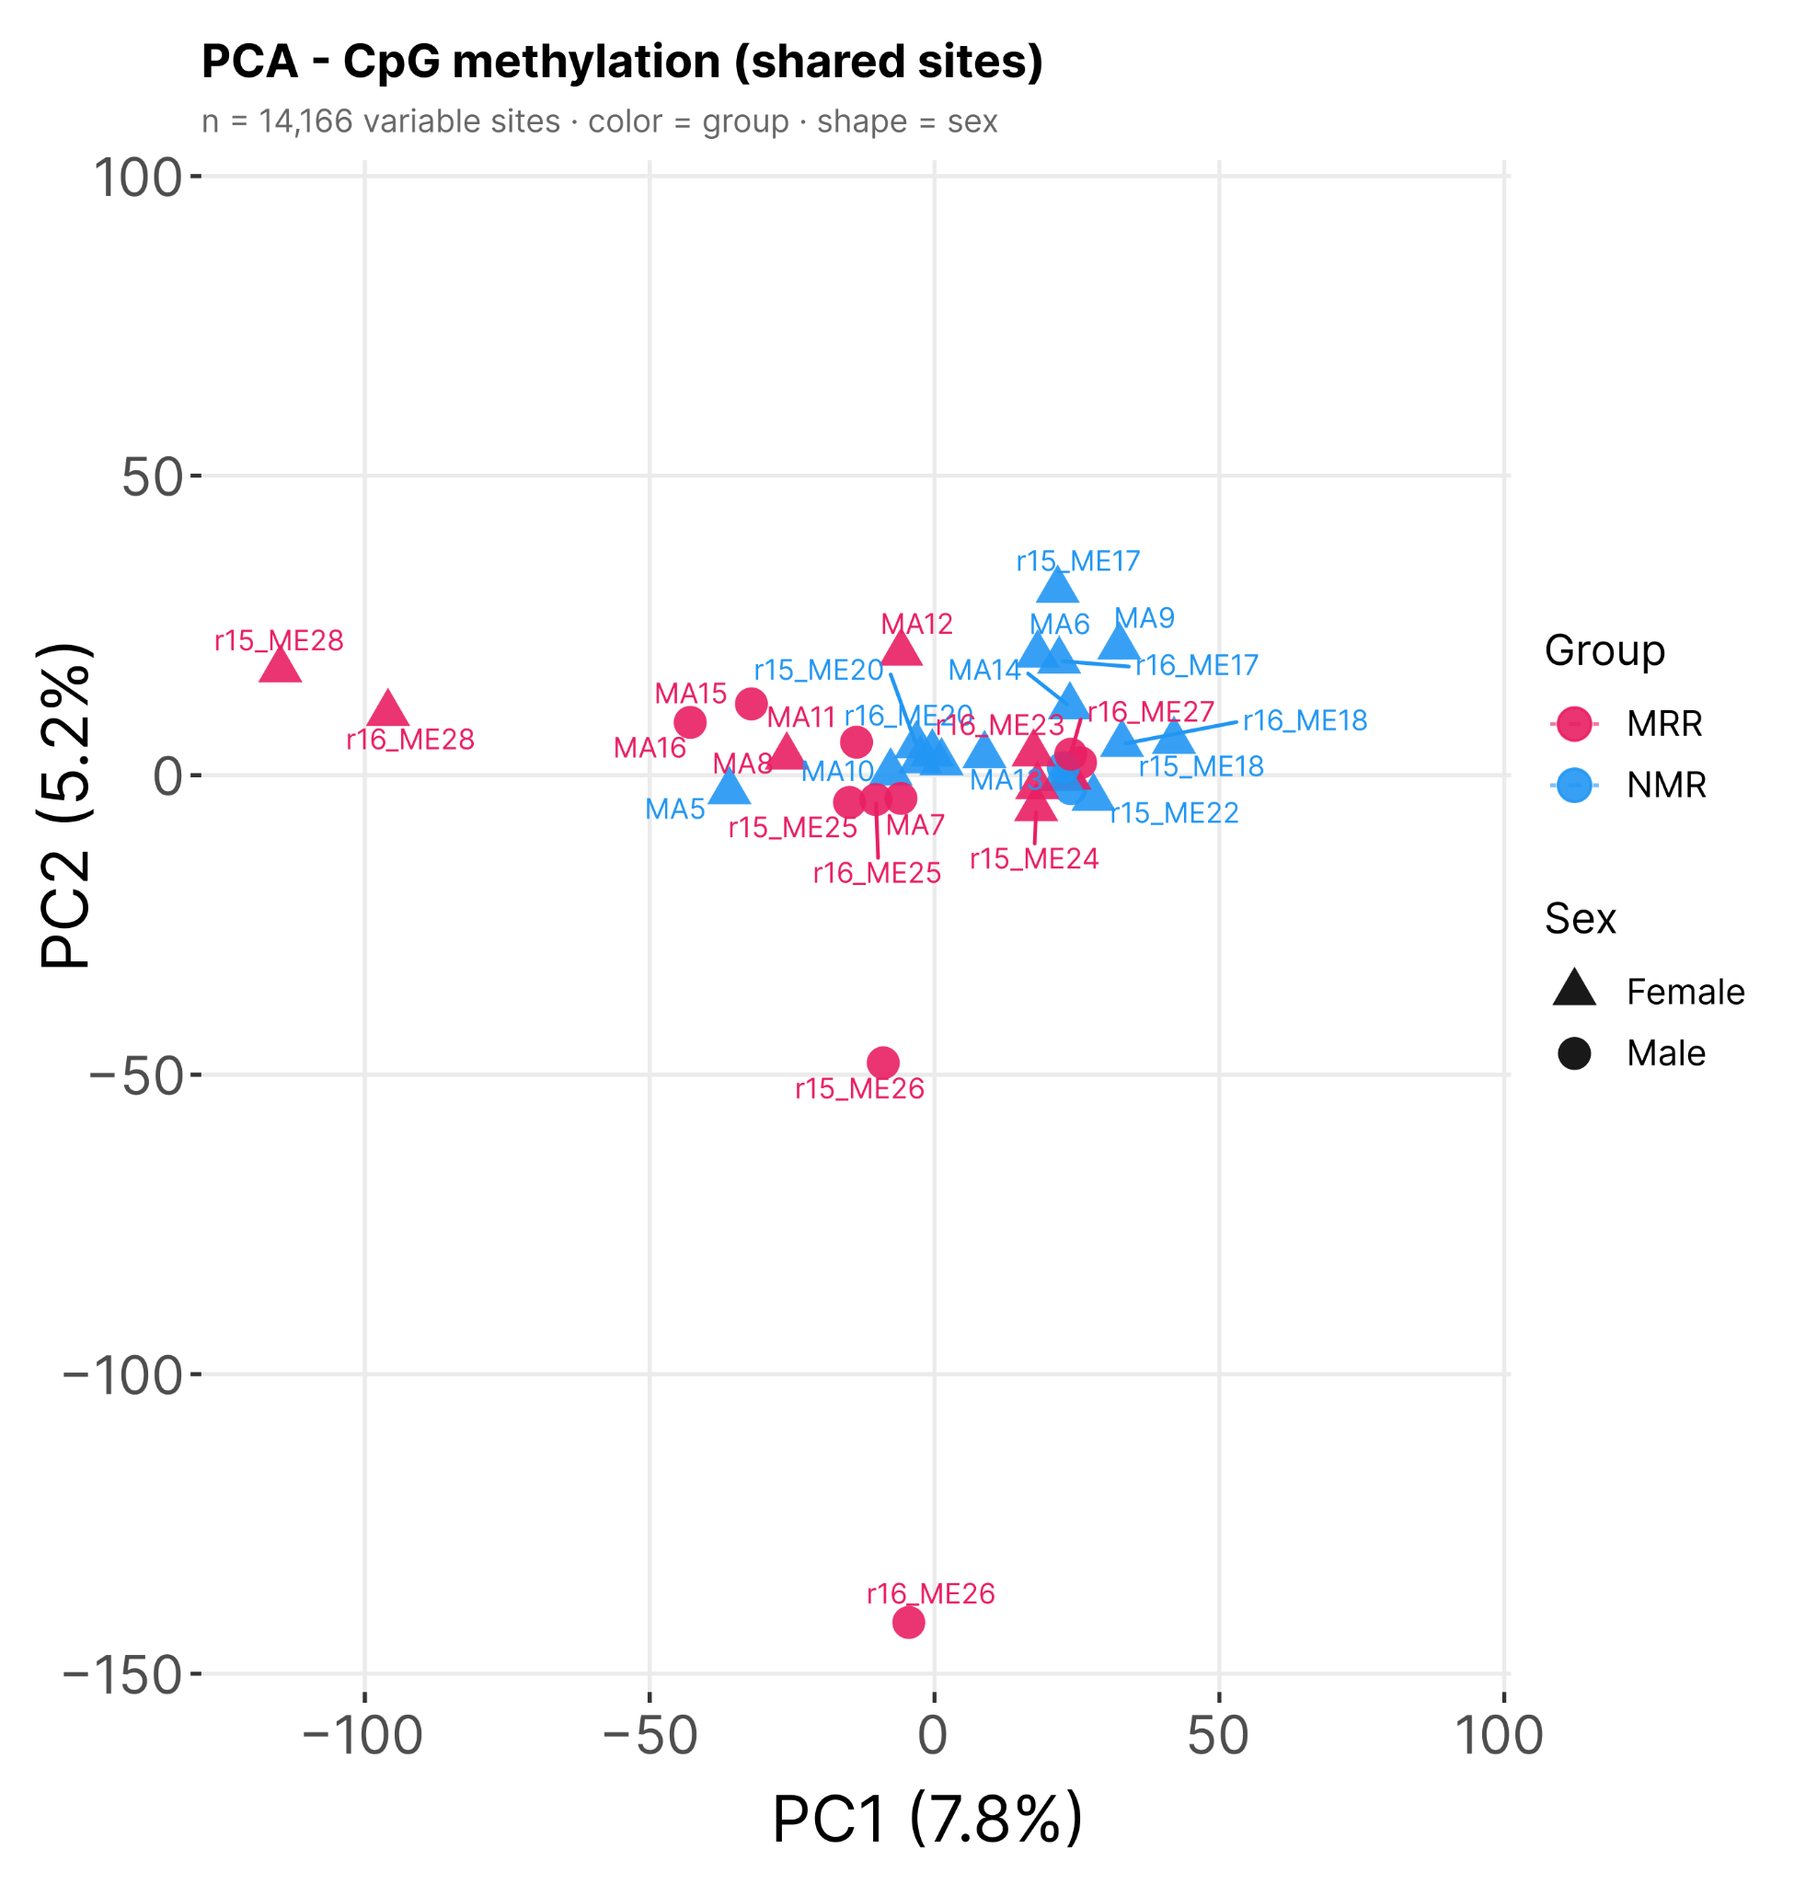
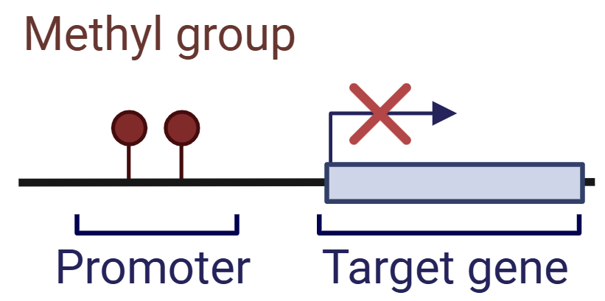
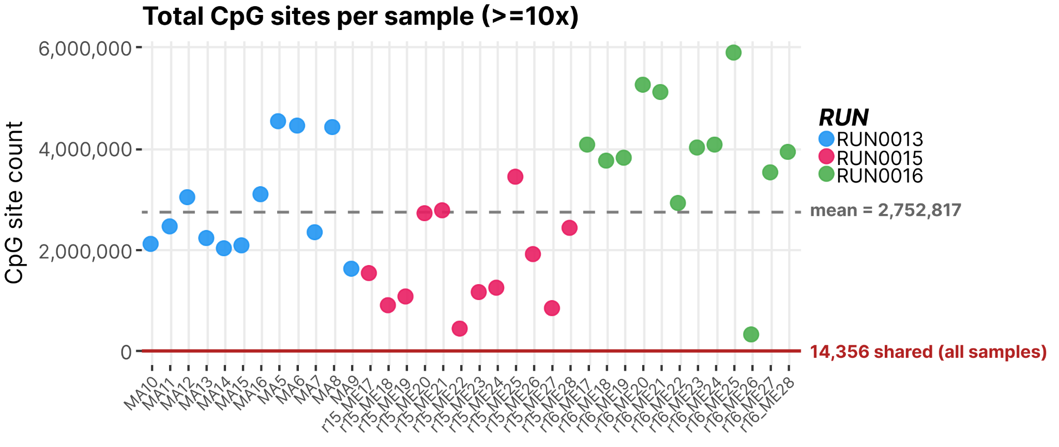
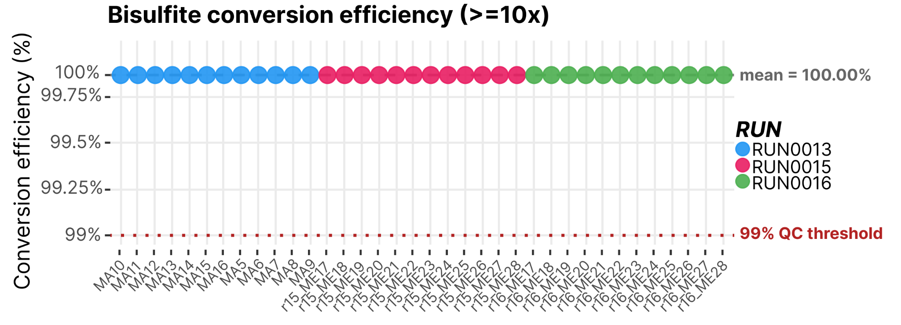
Ongoing Work: DNA methylation analysis
Suren Davitavyan,
PhD
36 samples so far sequenced

Slide 9
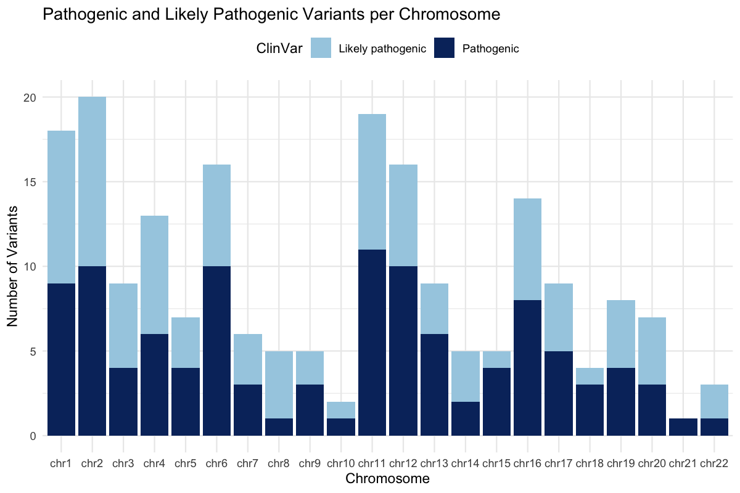



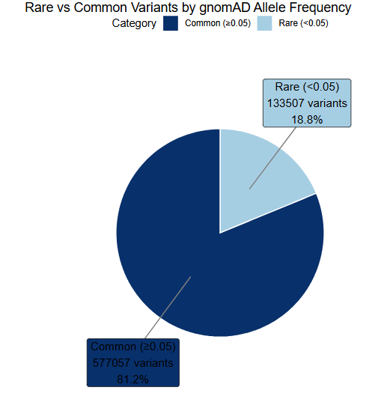

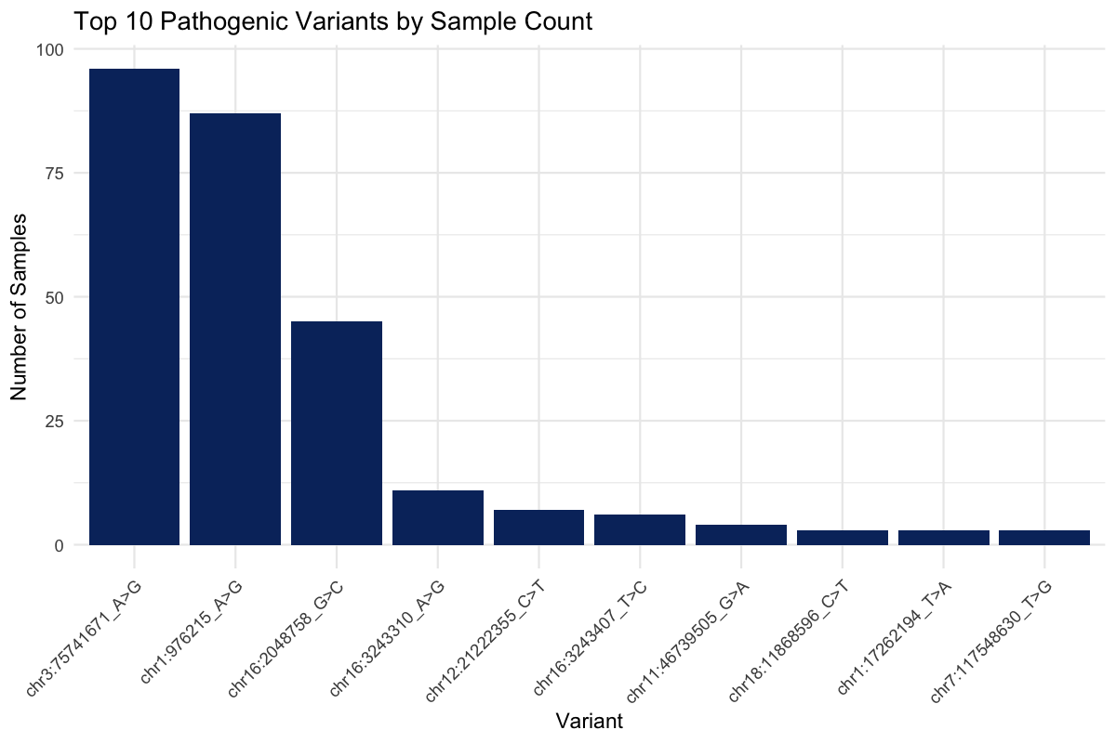

Ongoing Work: Whole exome sequencing analysis
135 samples so far sequenced
Exon 1
Exon N
Yeva Bareghamyan,
PhD student
Narineh Kianian,
PhD student
Common (>0.05)
577057 variants
81.2%
Hovhannes Hovhannisyan,
MD

Slide 10
Publications
1. Stepanyan A, Arakelyan A, Schug J. Transcriptome alterations in long-term mining region residents: Insights into immune response and molecular pathways. Environ Int. 2025 Mar;197:109344. doi: 10.1016/j.envint.2025.109344. Epub 2025 Feb 21.
2.Bareghamyan Y, Minasyan A, Davitavyan S, Petrackova A, Savara J, Nesnadna R, Kriegova E, Schug J, Arakelyan A, Stepanyan A. Integrated analysis of the blood metallome and DNA methylation, gene expression, and protein levels of immune-associated genes in residents from mining region. Environ Geochem Health. 2026 Jan 4;48(2):81. doi: 10.1007/s10653-025-02958-z.
Conferences: lUTOX 17th International Congress of Toxicology, October 15 to 18, 2025, Beijing, China
Future work
Continue epigenetic experiments to better understand molecular mechanisms underlying exposure-related effects.
Expand the exposomics research framework to further investigate environmental and biological interactions.
Develop and integrate multi-omics datasets, including WES, RRBS, transcriptomics, and metallomics.
Investigate associations between metal levels and genetic variants.

Slide 11
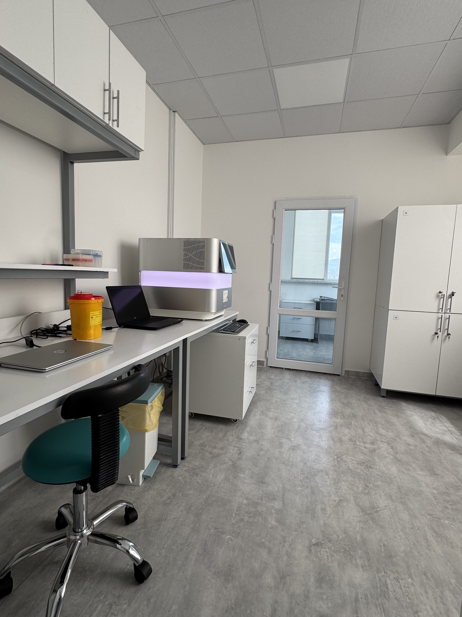
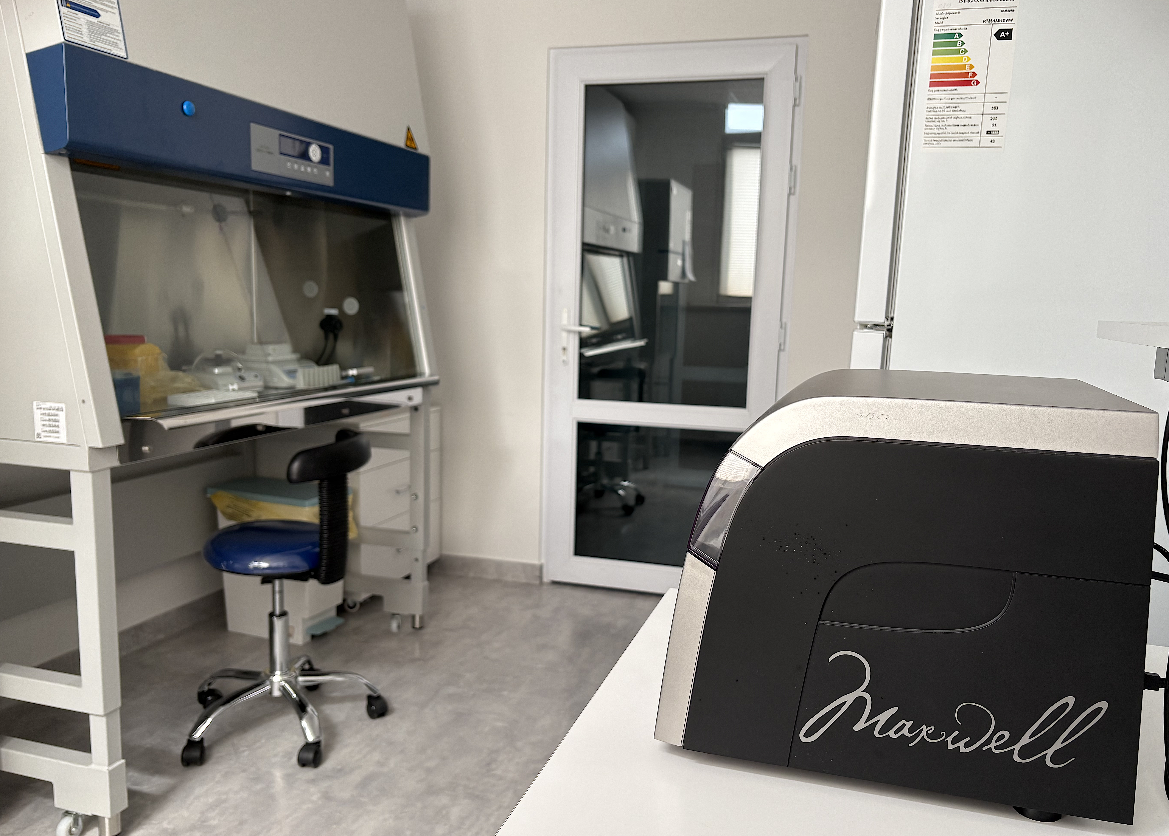
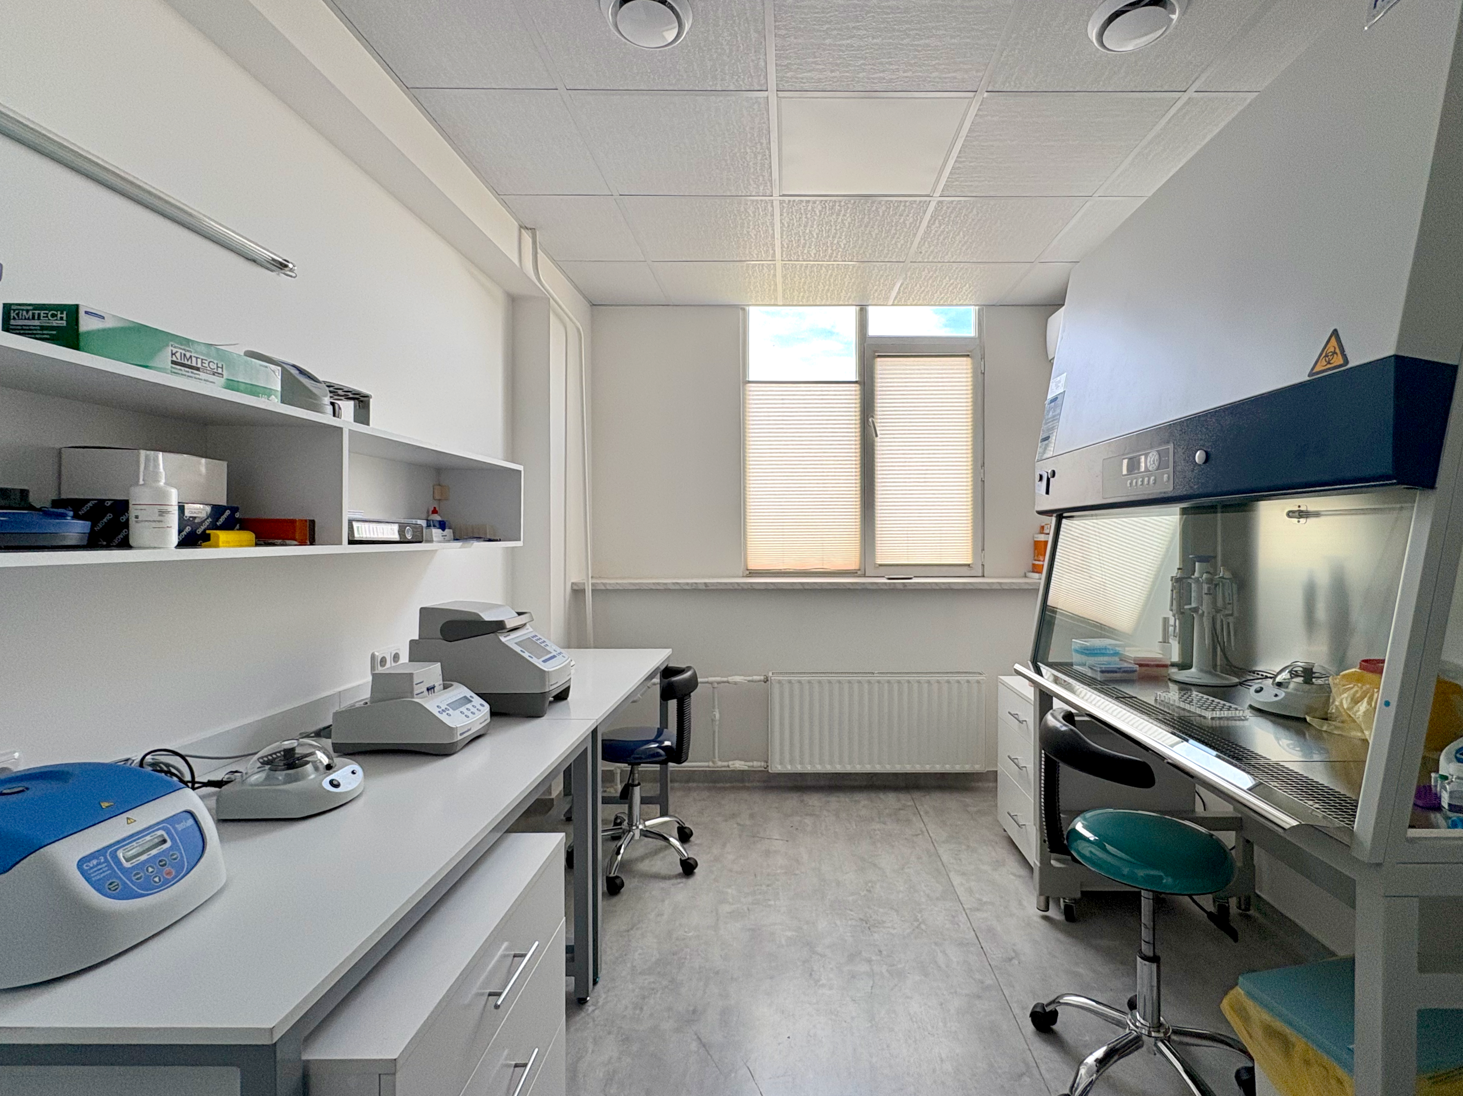

Infrastructure Aim: Laboratory Layout & Equipment
Extraction Room
Library Prep Room
Sequencing Room
Research Resource Identifier (RRID): SCR_026811

Slide 12


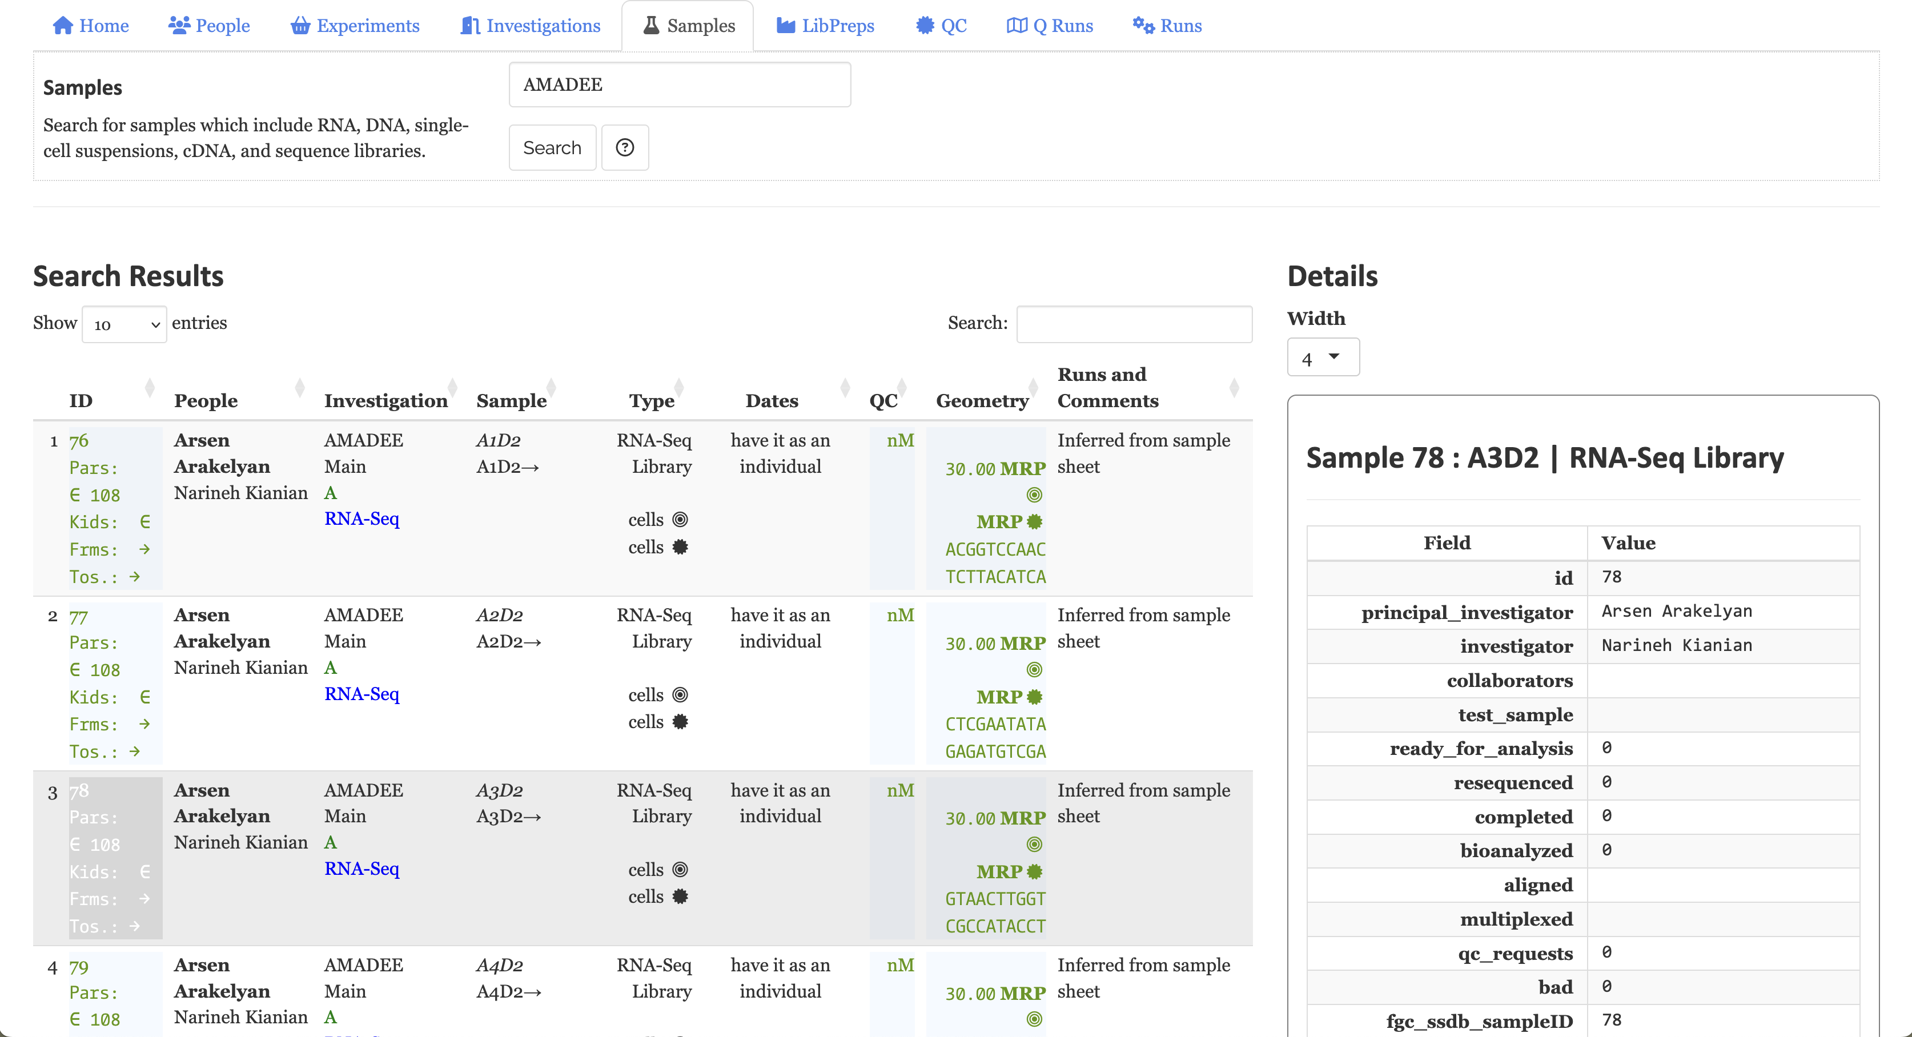
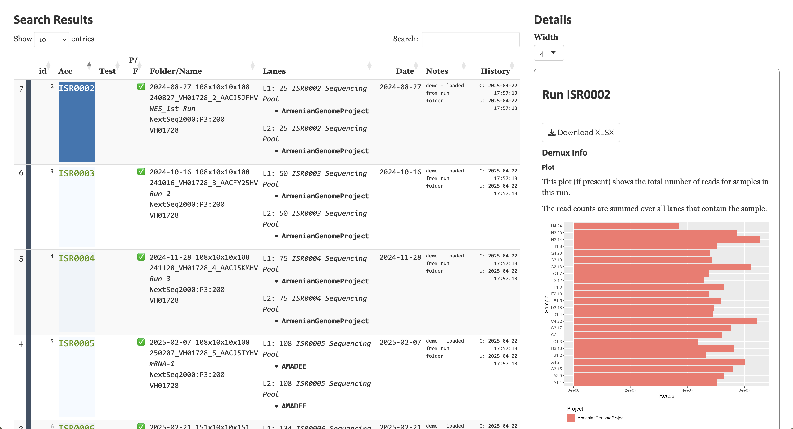
LIMS։ Laboratory Information Management System

Slide 13
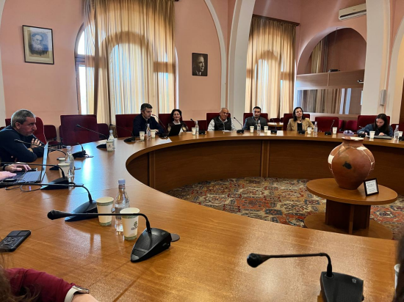
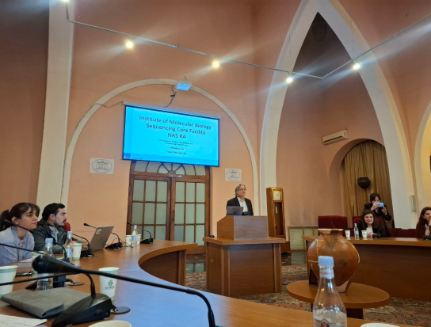
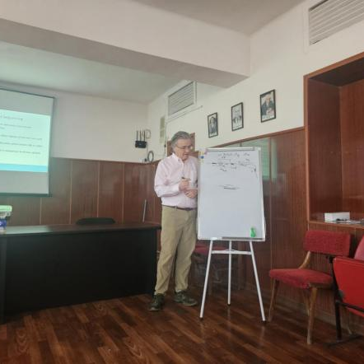
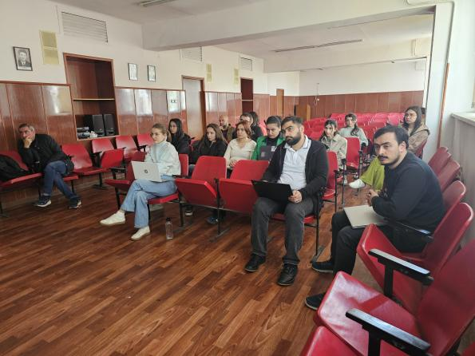
Community Engagement & Training
Workshop: Next-Generation Sequencing Core Facility: Research and collaboartion Opportunities, April 30, 2025
April 17–21, 2025, a three-day training course titled “Introduction to Next Generation Sequencing”

Slide 14
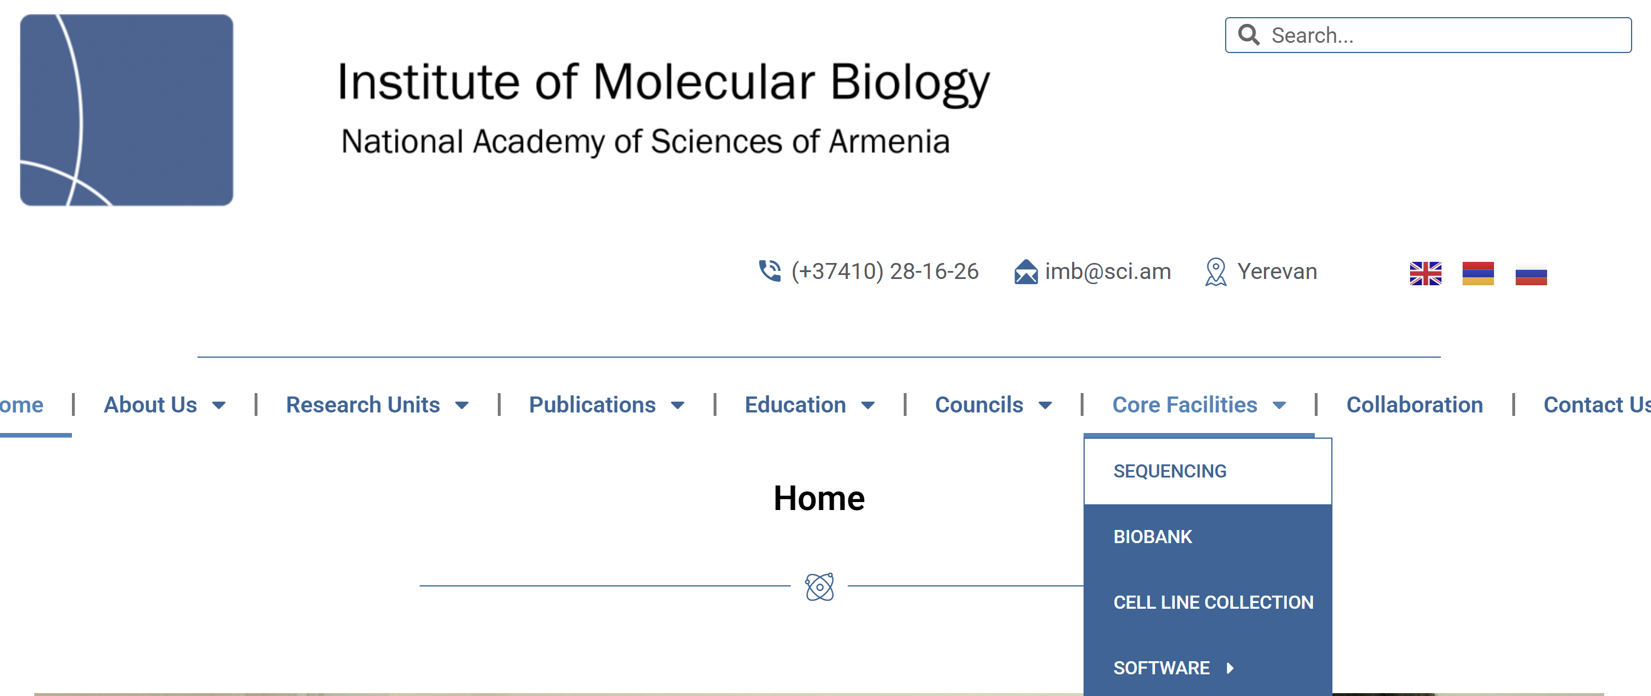
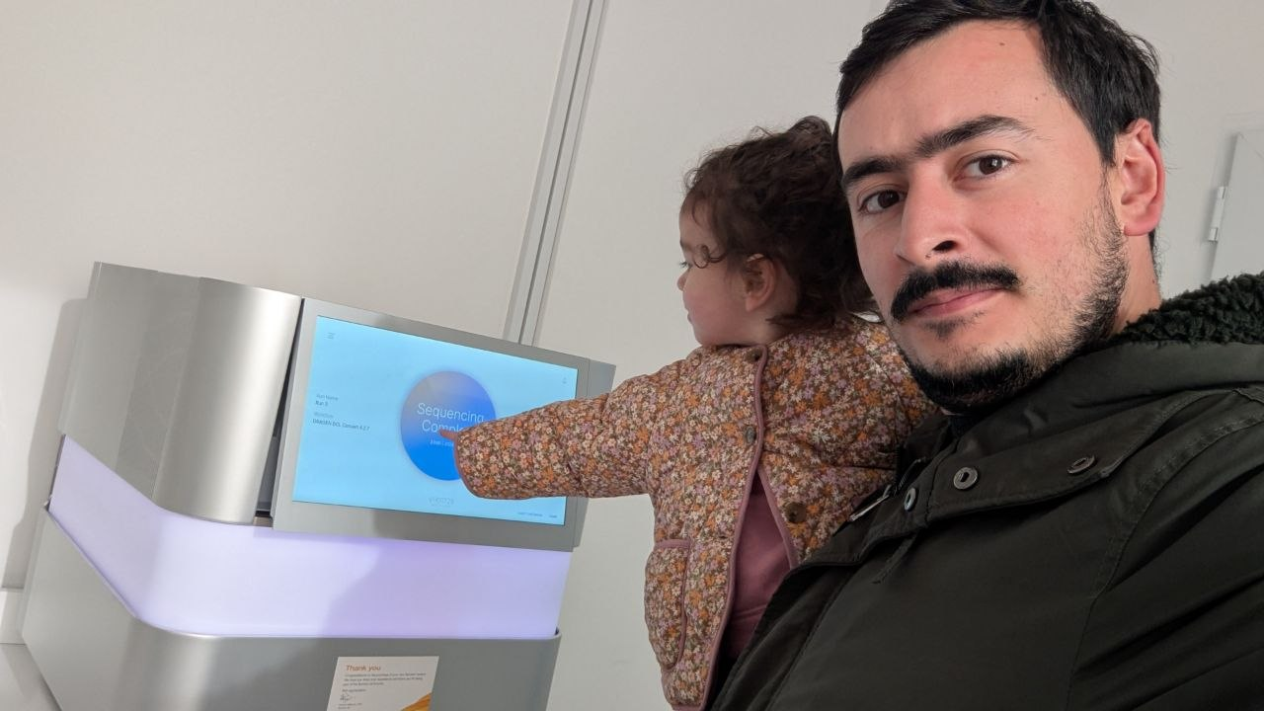
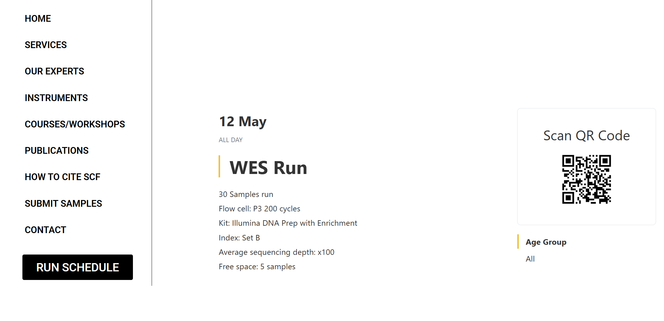

Core Facility: Services & Specifications

Slide 15



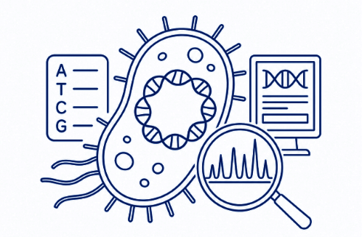




Core Facility: Services & Specifications
Exon 1
Exon N
Whole Exome Sequencing (WES)
Investigates genetic variants in protein-coding regions of the genome associated with diseases and biological traits.
Reduced Representation Bisulfite Sequencing (RRBS)
Analyzes DNA methylation patterns in CpG-rich genomic regions to study epigenetic regulation.
Transcriptome Sequencing
Measures gene expression and identifies RNA transcripts to understand cellular functions and molecular pathways.
Bacterial Genome
Determines complete bacterial genome sequences for identification, characterization, and antimicrobial resistance analysis.
Targeted Panels
Focused sequencing of selected genes or genomic regions associated with specific diseases, biomarkers, or research questions.
Gene 1
Gene 2
...
Gene N

Slide 16



Current Projects & Activity
2
8+
5
7
Completed
Projects
Ongoing
Projects
Collaborating
Research groups
Committee
New Call Applications
Tiltle: Effects of environmental metal levels on soil metagenomics in urban Armenia

Slide 17


















Future work
Implement new sequencing protocols
(cfDNA sequencing, metagenomics, non-coding RNA sequencing, histone modification)
Establish data usage regulations and collaboration agreements
Increase the visibility and outreach of the core facility
Apply new international collaborative grants and partnerships
Strengthen training and user support program
Apply for equipment grants to expand the multi-omics core facility to support the development
of exposomics research capabilities (metallomics, promeomics, metabolomics)
Genome
Epigenome
Transcriptome
Proteome
Metabolome
Metallome

Slide 18
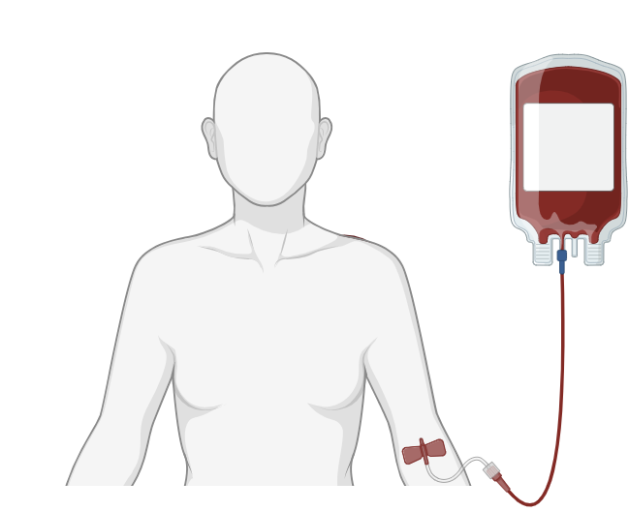







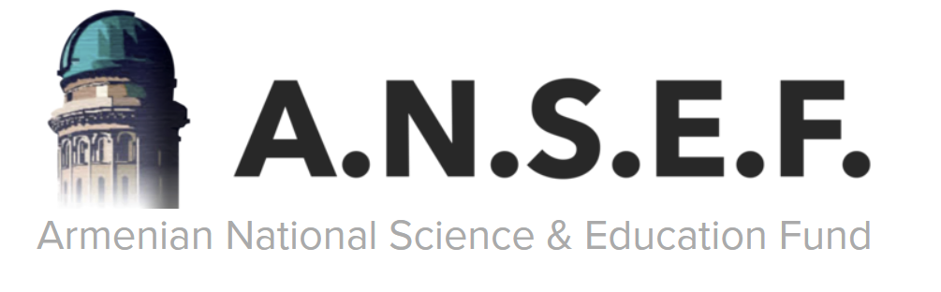

Acknowledgments
Sequencing Core Facility
Study Volunteers
Narine Kianian
Suren Davitavyan
Hovhannes Hovhannisyan
Blood Collection Support
Zaruhi Khachatryan Varduhi Hayrapetyan
Lilia Khachaturyants
Penn Genomics and Sequencing Core
Department of Immunology
Laboratory of Human Genomics
Jonathan Schug
Kyia Rutherford
Olga Smirnova
Eva Kriegova
Anna Petrackova
Jakub Savara
Romana Nesnadna
Arsen Arakelyan
Siras Hakobyan
Varduhi Hayrapetyan
Arpine Minasyan
Hovsep Ghazaryan
Yeva Bareghamyan
Meline Hakobyan
Maria Nikoghosyan
Gisane Lazyan
Lilit Ghukasyan
Roksanna Zakharyan
Andranik Chavushyan
Laboratory of Molecular Genetics
Rouben Aroutiounian
Galina Hovhannisyan
Tigran Harutyunyan
Angela Sargsyan
Synchrotron Research Institute
Gohar Tsakanova
Anna Ayvazyan
Center for ecological-noosphere studies
Lilit Sahakyan
Gevorg Tepanosyan
David Pipoyan
Funding
The Higher Education and Science Committee
European Federation of Immunological Societies
Armenian National Science and Education Fund
The Fulbright Foreign Student Program

Slide 19
Շնորհակալություն

